Slide 1
Machine learning
Support Vector Machine
Prepared by
KEJI, Adebayo, Abdulganiyu

Slide 2
DATA
Data is being produced and sorted continuously ("big data")
Data is not random; it contains structure that can be used to predict outcomes, or gain knowledge in some way.
Example: patterns of Amazon purchases can be used to recommend items.
Data mining: the application of ML methods to large databases.
Example of ML applications: fraud detection, medical diagnosis, speech or face recognition.

Slide 3
MODELS
ML is programming computers using data (past experience) to optimize a performance criterion.
. ML relies on:
. Statistics: making inferences from sample data.
. Numerical algorithms (linear algebra, optimization): optimize criteria, manipulate models.
. Computer science: data structures and programs that solve a ML problem efficiently.
. A model: is a compressed version of a database;
. extracts knowledge from it;
. does not have perfect performance but is a useful approximation to the data.

Slide 4
Con’t
Learning denotes changes in a system that enable the system to do the same task more efficiently next time. Learning is an important feature of Intelligence.
A computer program is said to learn from experience E with respect to some class of tasks T and performance measure P, if its performance at tasks T, as measured by P, improves with experience E.

Slide 5
Type of Machine learning Model
Supervised learning: labels provided
Classication (pattern recognition):
Face recognition.
Speech recognition.
Regression: the labels to be predicted are continuous:
Predict the price of a car from its mileage.
Navigating a car: angle of the steering.
kinematics of a robot arm:

Slide 6
Con’t
Unsupervised learning: no labels provided, only input data.
Learning associations:
Basket analysis: let p(Y jX) = \probability that a customer who buys product X also buys product Y ", estimated from past purchases. If p(Y jX) is large (say 0.7), associate "X ! Y ". When someone buys X, recommend them Y
Clustering: group similar data points.
Density estimation: where are data points likely to lie?
Dimensionality reduction: data lies in a low-dimensional
Feature selection: keep only useful features.
Semi supervised learning: labels provided for some points only.
Reinforcement learning: and a sequence of actions (policy) that reaches a goal. No supervised output but delayed reward.
Example: playing chess or a computer game, robot in a maze.

Slide 7
Learning a class from examples: two-class problems
We are given a training set of labeled examples (positive and negative)
Input representation: we need to decide what attributes (features) to use to describe the input patterns (examples, instances).
Training set: X = f(xn; yn) input vector and Yn (0,1) its class label.
Noise is any unwanted anomaly in the data. It can be due to:
. Imprecision in recording the input attributes: xn.
. Errors in labeling the input vectors: yn.
. Attributes not considered that affect the label (hidden or latent attributes, may be unobservable).
. Noise makes learning harder.

Slide 8
Noise is any unwanted anomaly in the data. It can be due to:
. Imprecision in recording the input attributes: xn.
. Errors in labeling the input vectors: yn.
. Attributes not considered that affect the label (hidden or latent attributes, may be unobservable).
. Noise makes learning harder.

Slide 9
Multi-class problem
With K classes, we can code the label as an integer y = k 2 1, . . . ,K, or as a one-of-K binary vector y = (y1, . …..yK)T 2 0, 1K (containing a single 1 in position k).

Slide 10
Estimation of missing values
. For any given example xn, the values of some features x1n; : : : ; xDn may be missing. Ex: survey non response. Strategies to deal with missing values in the training set:
.Discard examples having any missing values. Easy but throws away data.
. Fill in the missing values by estimating them (imputation):
Mean imputation: impute feature d as its average value over the examples where it is present (for discrete features: mode imputation). Independent of the present features in xn.
Imputation by regression: predict the value of xdn from the values of the present features in xn. The regression model is
learned using present values in the training set.
Multiple imputation: create M complete training sets, each a sample from a model of the missing data, and combine the M resulting trained models.

Slide 11
Outlier (novelty, anomaly) detection
Outlier (novelty, anomaly) detection
. An outlier is an instance that is very different from the other instances in the sample. Reasons:
Abnormal behaviour. Fraud in credit card transactions,
intruder in network trac, etc.
Recording error. Faulty sensors, etc.
. We can also identify outliers as points that are far away from other samples.

Slide 12
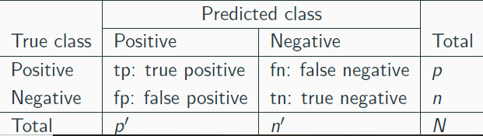
Measuring classifier performance
. The most basic measure is the classification error (or accuracy) in %:
. It is often of interest to distinguish the different types of errors: confusing the positive class with the negative one, or vice versa. Ex: voice authentication to log into a user account. A false positive (allowing an impostor) is much worse than a false negative (refusing a valid user).

Slide 13
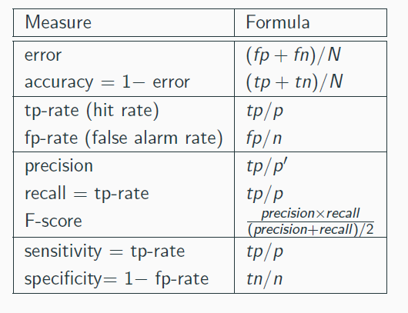
Metrics

Slide 14
Support Vector Machine

Slide 15
SVM
SVMs are a new generation of learning algorithms
• Discriminant-based method: it models the classification boundary, not the classes themselves.
• It can produce linear classifiers (linear SVMs) or nonlinear classifiers (kernel SVMs).
• Very effective in practice with certain problems:
• It gives good generalization to test cases.
• The optimization problem is convex and has a unique solution (no local optima).
• It can be trained on reasonably large datasets.
• Special kernels can be defined for many applications.
• It can be extended beyond classification to solve regression,
dimensionality reduction, outlier detection and other problems.

Slide 16
• Basic idea of support vector machines
:just like 1- layer or multi-layer neural nets
• Optimal hyperplane for linearly separable patterns
• Extend to patterns that are not linearly separable by transformations of original data to map into new space – the Kernel function
• SVM algorithm for pattern recognition.

Slide 17
Con’t
• Support vectors are the data points that lie closest to the decision surface (or hyperplane)
• They are the data points most difficult to classify
• They have direct bearing on the optimum location of the decision surface

Slide 18
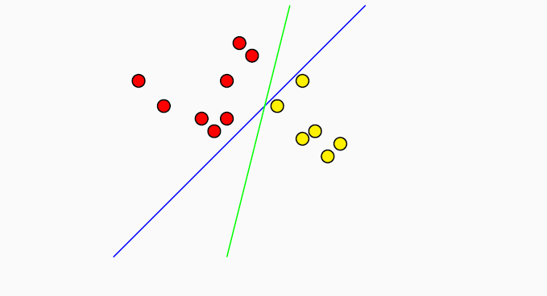
SVM hyperplane
In general, lots of possible solutions for a,b,c (an infinite number!)
• Support Vector Machine (SVM) finds an optimal solution

Slide 19
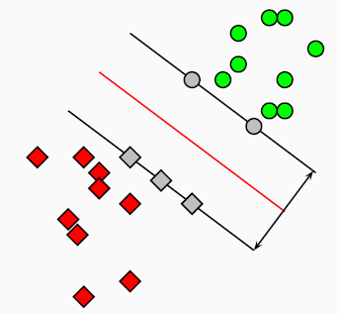
SVMs maximize the margin (Winston terminology: the ‘street’) around the separating hyperplane.
• The decision function is fully specified by a (usually very small) subset of training samples, the support vectors.
• This becomes a Quadratic programming problem that is easy to solve by standard methods

Slide 20
General input/output for SVMs just like for neural nets, but for one important addition
Input: set of (input, output) training pair samples; call the input sample features x1, x2, . . . , xn, and the output result y.
Typically, there can be lots of input features xi .
• Output: set of weights w (or wi ), one for each feature, whose linear combination predicts the value of y. (So far, just like
neural nets . . . )
Important difference: we use the optimization of maximizing the margin (‘street width’) to reduce the number of weights that are nonzero to just a few that correspond to the important features that ‘matter’ in deciding the separating line(hyperplane). . . these nonzero weights correspond to the support vectors (because they ‘support’ the separating hyperplane)

Slide 21
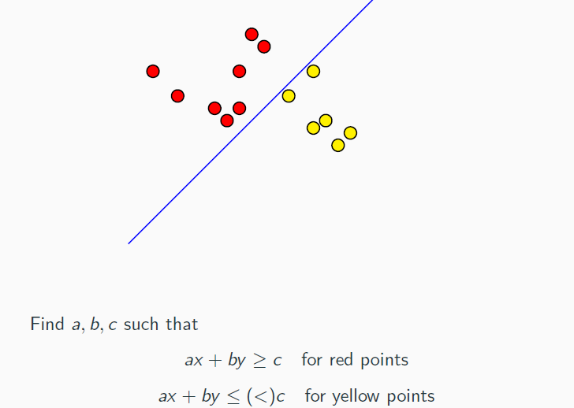

Slide 22
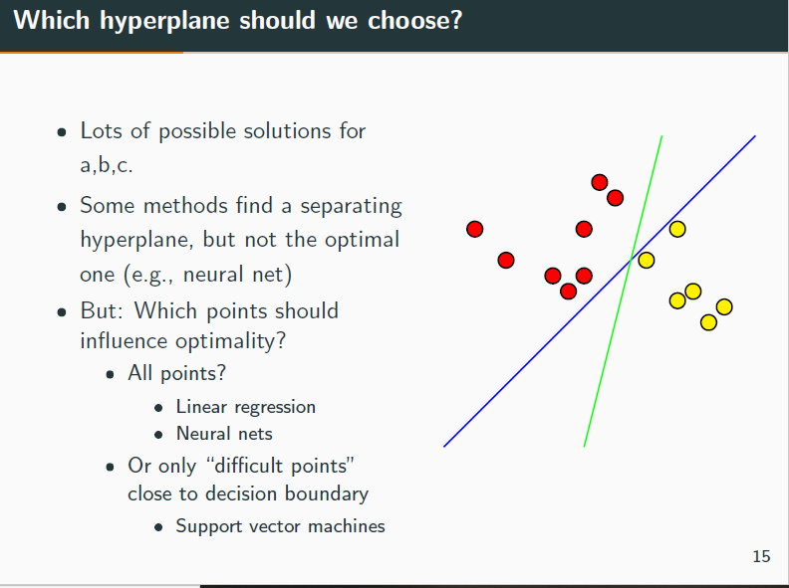

Slide 23
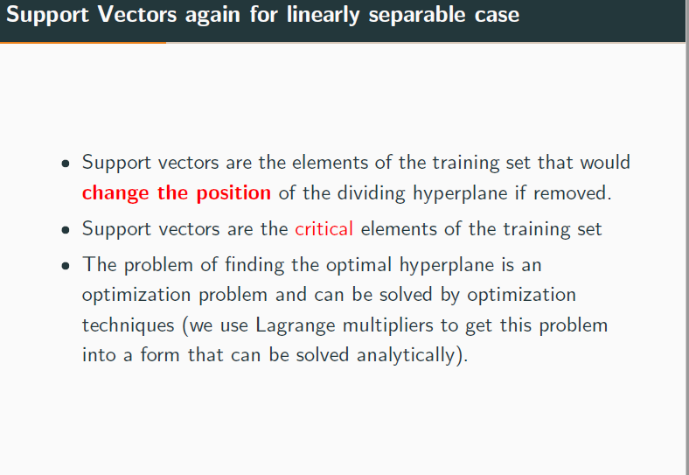

Slide 24
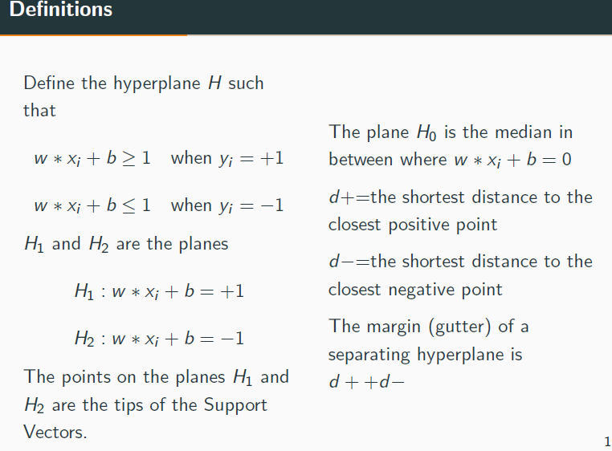

Slide 25
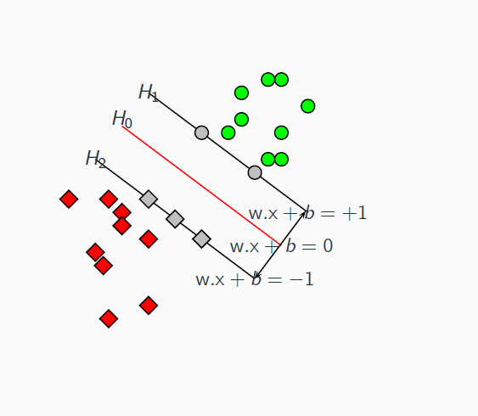

Slide 26
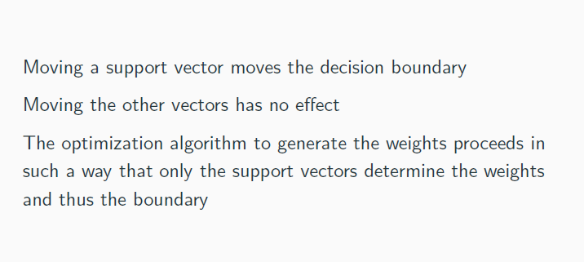

Slide 27
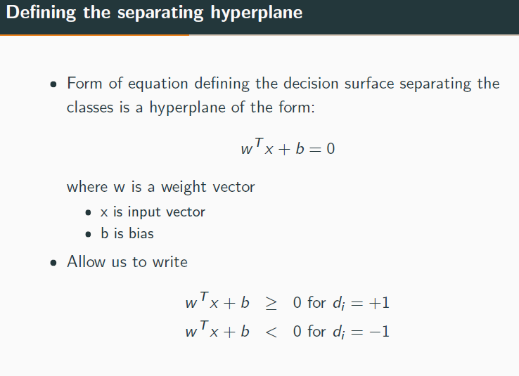

Slide 28
